Slide 1
SITE CLEAN-UP SOLUTIONS USING INNOVATIVE remediation
TECHNOLOGIES
Prepared by:
Envirorisk Consultants, Inc.
Kenneth Summerour, P.G.
ksummerour@eriskinc.com
www.eriskinc.com
NE Sales Office:
4 Beaver Brook Road
Lincoln Park, NJ 07035
973.714.0819
Atlanta Office (converted Brownfield):
601 S. Madison Ave
Monroe, GA
Mailing Address:
P.O. Box 945
Grayson, GA 30017
770.864.9789

Slide 2
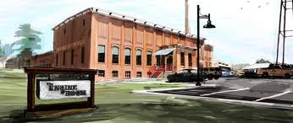

Envirorisk Consultants, Inc.
Who We Are
Envirorisk was formed in 1996 to provide innovative “best fit” environmental subsurface solutions from a business oriented perspective.
We are a full service environmental consulting firm specializing in in-situ remediation technologies including ISCO, ISCR, Enhanced Bioremediation, Surfactant injections, and Soil Blending.
Envirorisk focuses on environmental solutions, NOT just science.
We develop tailored strategies for each site, from bench scale testing in the laboratory to field execution, in an effort to expedite site closure with minimal time and expense.
Envirorisk’s office in a converted Brownfield
Prepared by Ken Summerour, P.G.
1

Slide 3
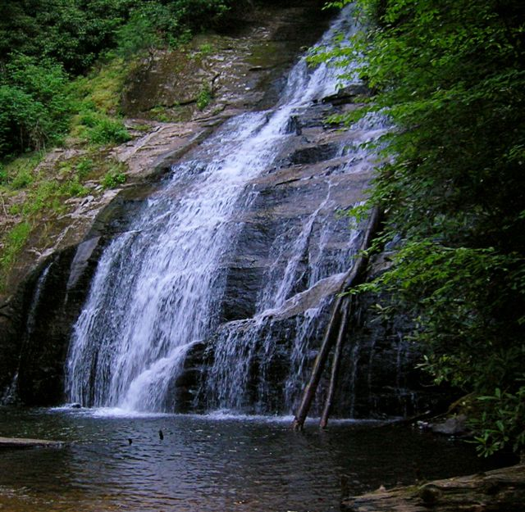
Envirorisk Consultants, Inc.
Services We Offer
Rapid Subsurface Assess/Plume Tracking
Source Area/Remedial Characterizations
Laboratory Treatability Studies
Injection treatments (ISCO, ISCR, Surfactants, Enhanced Bioremediation)
In-Situ/Ex-Situ Soil Blending (“green friendly” alternative to off-site landfiling)
Permeable Reactive Barrier Design/Installation
Mechanical Systems (forced surfactant flush, DPE, AS/SVE, etc.)
Corrective Plan Development/Remedial Design
Risk Assessments/Groundwater Modeling
Closure Strategies/Regulatory Negotiations
Expert Testimony/Litigation Support
Site Assessments/Facility Inspections
Prepared by Ken Summerour, P.G.
2

Slide 4

Site Clean-Up Strategies
Why do sites take so long to clean-up?
Technology challenges
(we used to think Pump-and-Treat was the answer!)
Difficult Subsurface Conditions
(low permeability soil, heterogeneity, NAPL, etc.)
Insufficient Assessment/Data Gaps
Cost Hurdles (how much will it really cost?)
Regulatory Challenges
(why do you have to draw a “clean” line
before starting clean-up?)
Prepared by Ken Summerour, P.G.
3

Slide 5

What is the Solution?
Develop a good conceptual model (example: source area blending combined with PRB)
Perform source area remedial characterizations (know how much you have to clean-up!)
Develop risk target levels with regulators early in the process/choose voluntary clean-up programs, if possible.
Focus clean-up efforts on source area first - new technologies (soil blending, ISCO, surfactant flushes) offer rapid treatment at reduced cost.
Recent innovations in In-situ methods now result in faster, more efficient clean-ups that actually work!
Prepared by Ken Summerour, P.G.
Prepared by Ken Summerour, P.G.
4

Slide 6
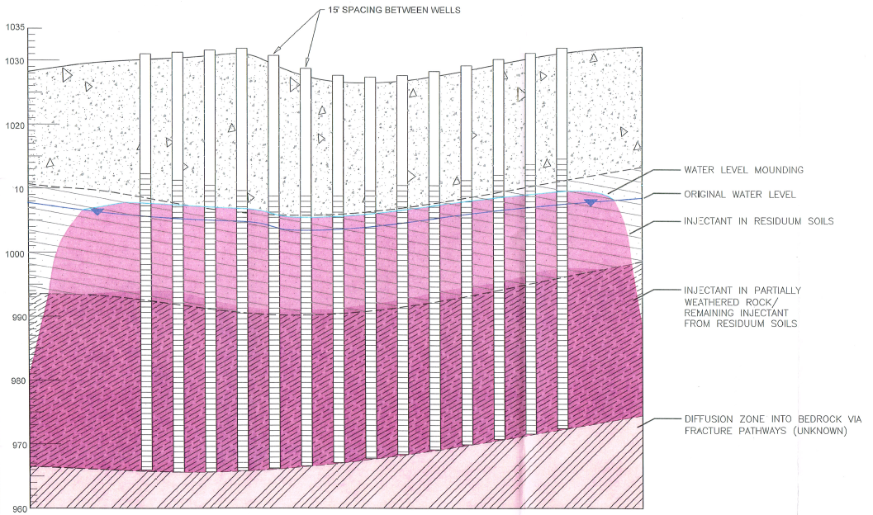
Overview of Remedial Technologies
Chemical Oxidation (ISCO if injected)
Chemical Reduction (ISCR if injected)
Enhanced Bioremediation
Surfactant Enhancements
Barrier Technologies (PRB, example below)
Prepared by Ken Summerour, P.G.
5

Slide 7
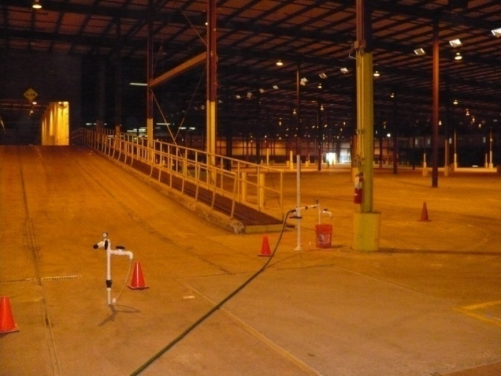

What is Chemical Oxidation?
Chemical Oxidation: Breaking bonds of organic molecules and inserting oxygen.
End products are carbon dioxide, water, and harmless salts.
Application methods include ISCO (direct injection), In-place soil blending, and Ex-Situ soil blending.
Used for source area or small area (“spot” treatments) as well as larger plume sites.
Treatment works on contact – need full oxidant contact for success.
Prepared by Ken Summerour, P.G.
6

Slide 8
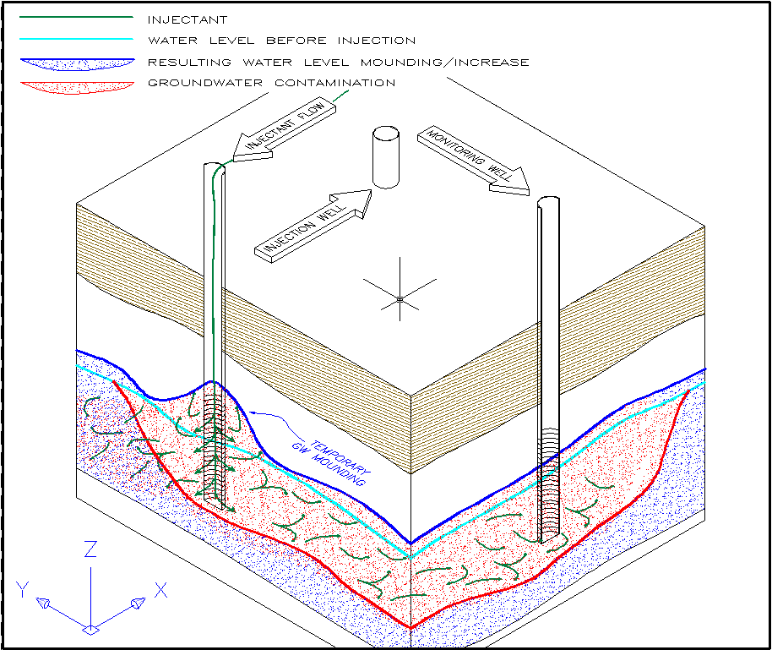
In-Situ Chemical Oxidation (ISCO)
ISCO involves low pressure injection to treat contaminants above/below water table.
Successful ISCO clean-ups involve proper oxidant selection and testing to determine dosing requirements.
To reach target goals, desorption of contaminants from soil matrix into the groundwater is required.
Conceptual Drawing of ISCO Process
Prepared by Ken Summerour, P.G.
9

Slide 9
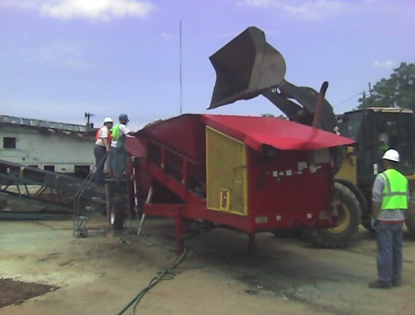
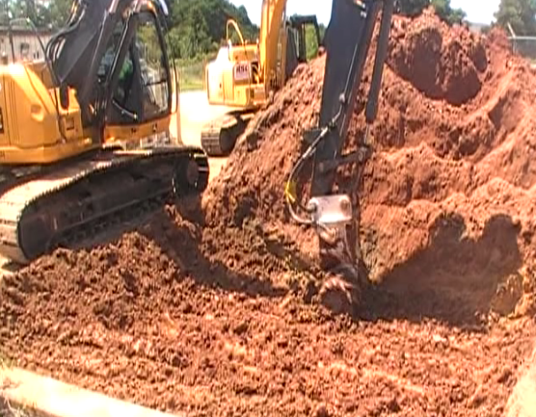
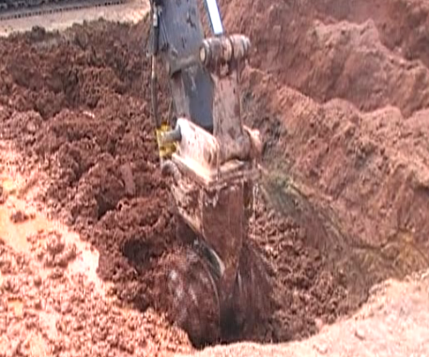
In-Place Soil Blending/Ex-Situ Blending
In-place soil blending utilizes high torque ratio excavators or auger driven equipment to mix oxidants/amendments directly into the soils.
Ex-situ soil blending generally utilizes modified pug mills for chemical treatment prior to returning to the excavation. This method offers maximum oxidant contact. Can achieve low levels depending on oxidant demand!
Treated soils can be stabilized using lime derivative chemical blends to allow re-use. Performance guarantees are available for some sites.
Soil blending methods are “green friendly” promoting recycling vs. dig-n’-haul and off-site land filling.
Prepared by Ken Summerour, P.G.
10

Slide 10
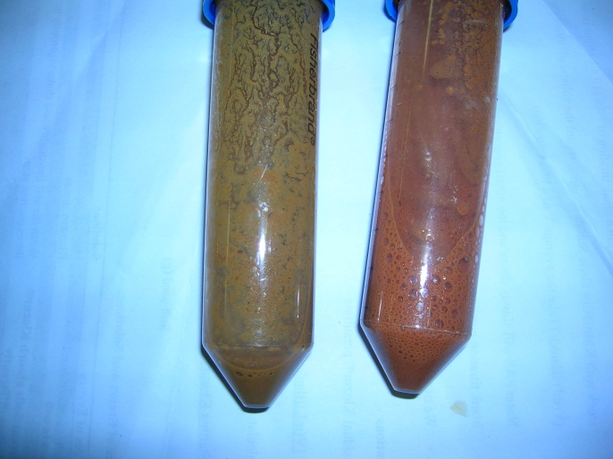
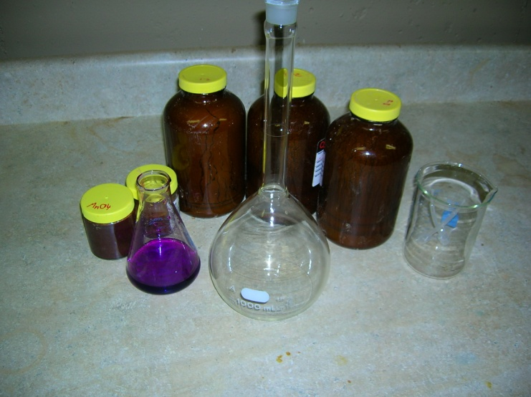

Types of Chemical Oxidants
Common oxidants include:
Catalyzed hydrogen peroxide (CHP)
Activated sodium persulfate
Sodium and potassium permanganate
Surfactant enhanced oxidation
Prepared by Ken Summerour, P.G.
11

Slide 11
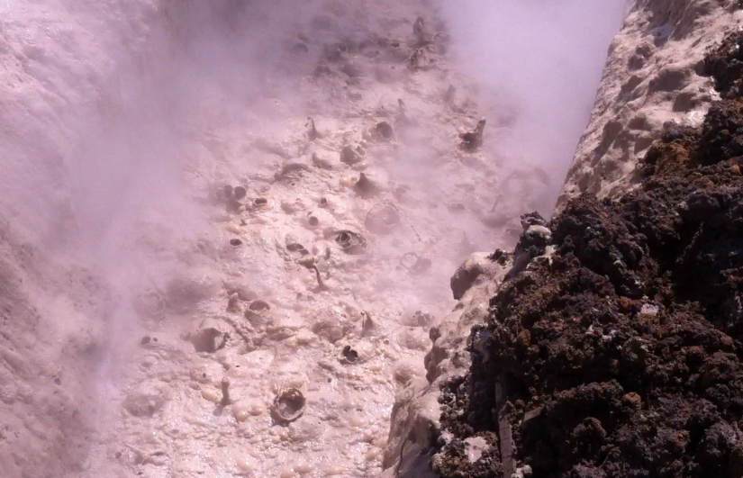
Oxidant Descriptions
Catalyzed Hydrogen Peroxide (CHP)/Modified Fenton’s
CHP or modified Fenton’s consists of hydrogen peroxide combined with an iron catalyst (chelates, iron salts), producing hydroxyl radicals (OH⁻).
Basic reaction: H₂O₂ + Fe⁺² → OH⁻ + OH⁻ + Fe⁺³
Efficient in a short period of time/breaks down soil structure.
Effective on a variety of hydrocarbons including NAPL.
Effective on wide range of compounds including recalcitrant compounds such as PAHs, PCBs, and
Dioxins.
Can easily combine use of CHP with
mechanical extraction.
Prepared by Ken Summerour, P.G.
12

Slide 12
Oxidant Descriptions (cont.)
Activated Sodium Persulfate
Oxidation is performed by combining sodium persulfate with a catalyst to release sulfate radicals.
Reaction: S₂O₈⁻² + activator → SO₄^{.-} + (SO₄ ^{.-} or SO₄⁻²)
Common activators include: heat, metal catalysts (iron), H₂O₂, and pH buffers (<3 or >10), high pH buffering is preferred.
Sulfate radicals comparable in oxidation strength to OH⁻ radicals released during CHP oxidation.
Sulfate radicals have a long persistence in subsurface (30-60 days) and low natural oxidant demand.
Successful on a variety of VOCs and recalcitrant compounds.
Can be combined with oxygen release compounds to facilitate “treatment train” approach using aerobic bioremediation.
Prepared by Ken Summerour, P.G.
13

Slide 13
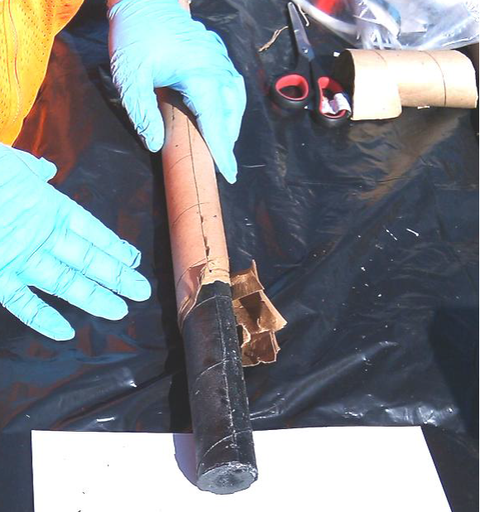

Oxidant Descriptions (cont.)
Sodium or Potassium Permanganate
The permanganate ion is a selective oxidant that works well on double-bonded chlorinated ethenes (PCE, TCE) and can also treat phenols, PAHs, pesticides, explosives, and some aromatics (not benzene).
Weaker than radical oxidation: 1.7 eV as compared to 2.6 eV for SO₄^{.-} and 2.7 eV for OH⁻.
Long persistence in the subsurface (up to a year).
Purple color aids in determining radius of influence (ROI).
Can also be utilized for longer term treatment of PAHs following CHP.
New permanganate candles offer low cost barrier treatment.
Prepared by Ken Summerour, P.G.
14

Slide 14
Oxidant Descriptions (cont.)
Surfactant and Oxidant Combinations
Surfactants are utilized to break down the interfacial tension between the fuel/oil and soil particles creating an emulsion.
Emulsions often allow more effective oxidant treatment of NAPL/“hot” pockets.
Surfactants may be utilized to flush and capture NAPL followed by an oxidant treatment.
Prepared by Ken Summerour, P.G.
15

Slide 15
Enhanced Bioremedial/Chemical Reduction
Enhanced bioremedial and chemical reduction/ISCR applications may be applied through direct injection, blending methods, or PRBs.
Oxygen release products provide aerobic treatment of BTEX, fuels, PAHs, etc. and can be combined chemical oxidation.
Emulsified oils, lactate-release products, ZVI, etc. are used to supply a hydrogen source for reductive de-chlorination.
ZVI and nZVI are also used in chemical reduction applications which utilize abiotic chemical oxidation under strongly reducing conditions.
Chemical reduction is commonly used for the treatment of large chlorinated plumes, metals, explosives, etc.
New biogeochemical reduction process (BiRD®) provides a low cost treatment for treatment of chlorinated VOCs and metals.
Prepared by Ken Summerour, P.G.
16

Slide 16
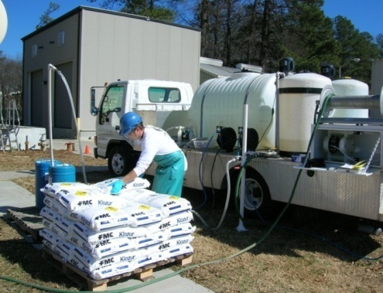
Select Case Studies
Surfactant Oxidation, Former Trucking Site: Atlanta, GA
Former RCRA Facility: Opelika, AL
Wood Treatment Facility: Manor, GA
Former Auto Dealer: Dalton, GA
Prepared by Ken Summerour, P.G.
17

Slide 17
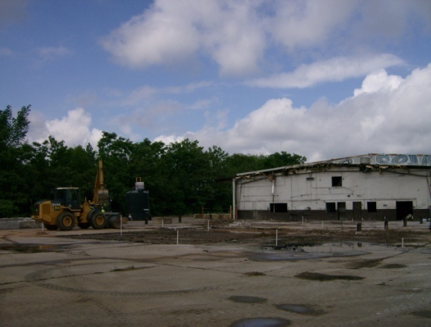
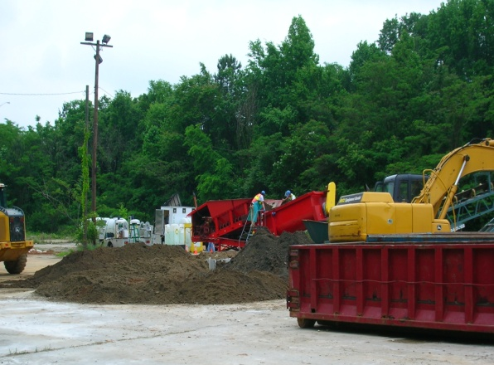
Surfactant Oxidation–Former Trucking Site
Overview
Site is located in the Piedmont Province in a topographic depression. Soils consist of micaceous sandy-silt/silty-sand saprolite derived from weathering of schist and gneiss bedrock.
Free phase diesel NAPL observed in several wells in thicknesses >0.5 foot.
No nearby groundwater receptors-site clean-up limited to NAPL removal only.
Assigned to State clean-up contractor under Pay-for Performance contract.
Prepared by Ken Summerour, P.G.
31

Slide 18
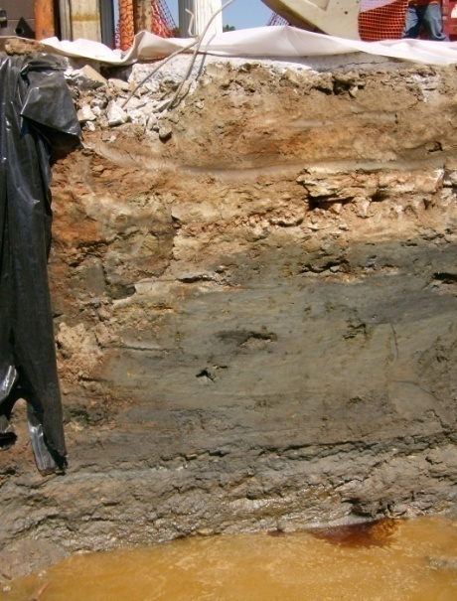
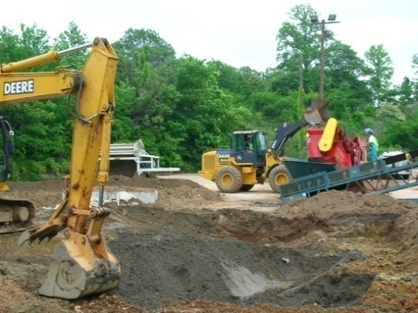
Surfactant Oxidation–Former Trucking Site (cont.)
Selection of Remedial Method
Aquifer testing and AS/SVE pilot testing performed indicated limited radial influence and hydraulic short circuiting due to bedrock fracturing.
Based on shallow depth to groundwater (5-8 feet), soil excavation and off-site disposal previously proposed followed by pump-and-treat using horizontal wells.
A “green friendly” strategy promoting recycling vs. off-site disposal was offered at a lower cost than dig-n-haul and pump-and-treat.
The remedial plan consisted of soil blending using S-ESCO®, a proprietary surfactant of VeruTEK.
Prepared by Ken Summerour, P.G.
32

Slide 19
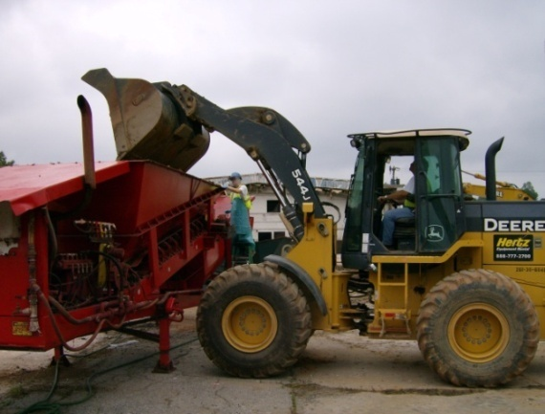
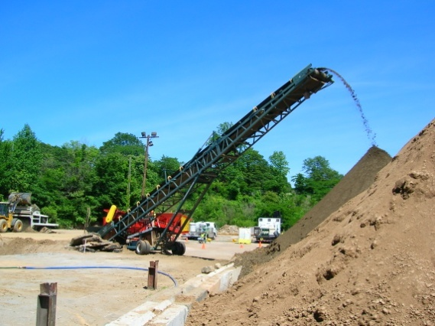
Surfactant Oxidation–Former Trucking Site (cont.)
Treatment Process
Removal of 1 to 3 feet of overburden followed by excavation of impacted soils from 11 to 12 feet.
Contaminated water/NAPL was pumped into storage tanks and hauled off by a licensed petroleum recycler.
Excavated soils were initially placed in a power screen to remove large debris.
Screened soils were placed in a specially designed Ex-situ soil blender with dual chemical feed.
Treated soils were fed by a conveyor into a lined treatment cell for 3 to 5 days retention.
Confirmatory samples were collected from stockpiled soils and excavation floor/sidewalls and tested for Diesel Range Organics.
Soils were backfilled and compacted using excavation equipment after treatment confirmation.
Prepared by Ken Summerour, P.G.
33

Slide 20
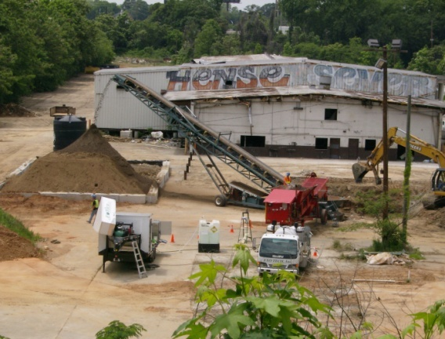
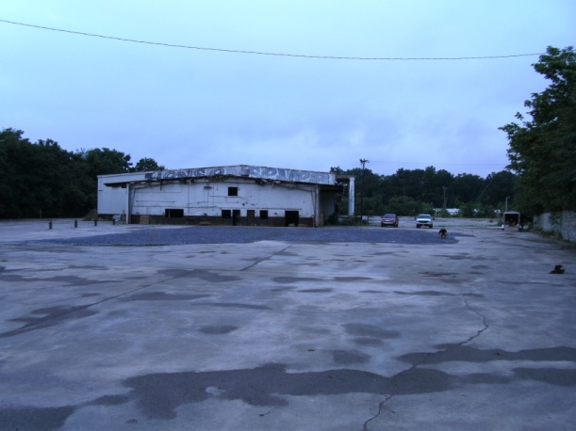
Surfactant Oxidation–Former Trucking Site (cont.)
Findings
Total of 4,000 yd³ of impacted soils were treated and 80,000 gallons of impacted water were transported to a recycler.
Ex-situ treatment required approximately 5 weeks to complete. Cost was <$200,000.
Process successfully treated NAPL to visual standards and DRO analysis confirmed concentration reduction to 1,000-5,000 ppm.
Replacement wells did not indicate free product over the 6-month monitoring period, resulting in a No Further Action (NFA) letter.
Prepared by Ken Summerour, P.G.
34

Slide 21
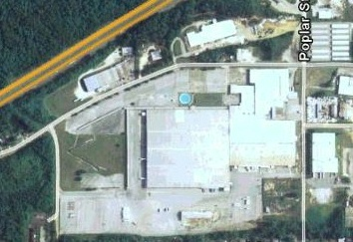
Former RCRA Facility
Historical Overview
Site was originally developed as a German POW camp during WWII. The site contains a 950,000 sf warehouse building.
Operated as a fitness equipment manufacturer from 1960-1997 which used 1,1,1-TCA, PCE, toluene, acetone, and other solvents.
A mixed 4.4 acre VOC plume was detected underneath the building, primarily 1,1-DCE, 1,1-DCA, TCE, and BTEX.
An exterior bulk storage area was also identified containing non-chlorinated VOCs in the soil resulting from paint solvent releases.
Prepared by Ken Summerour, P.G.
18

Slide 22
Former RCRA Facility (cont.)
Overview of Site Conditions
The aquifer consists of silty-sand/sandy-silt saprolite derived from granitic gneiss/mylonite. Depth to water is approximately 10-20 feet.
Performed rapid “plume tracking” with mobile lab- determined clean-up boundary (see next two slides).
No DNAPL on site confirmed by MIP investigation and NAPL screening.
Risk Assessment identified 9 target chlorinated VOCs exceeding RBTLs.
Rapid clean-up desired to facilitate future property sale. Site transferred from RCRA to Brownfield/VCP.
ISCO chosen due to site constraints (plume under slab), cost, and to provide the most rapid clean-up alternative.
Treatability test results indicated alkaline activated sodium persulfate was most suitable to site conditions.
Soil blending using chemical oxidants was chosen to treat the bulk storage area to avoid the high cost ($250/ton) of off-site disposal at a hazardous waste landfill.
Prepared by Ken Summerour, P.G.
19
Notes:
disposal at a hazardous waste landfill.

Slide 23
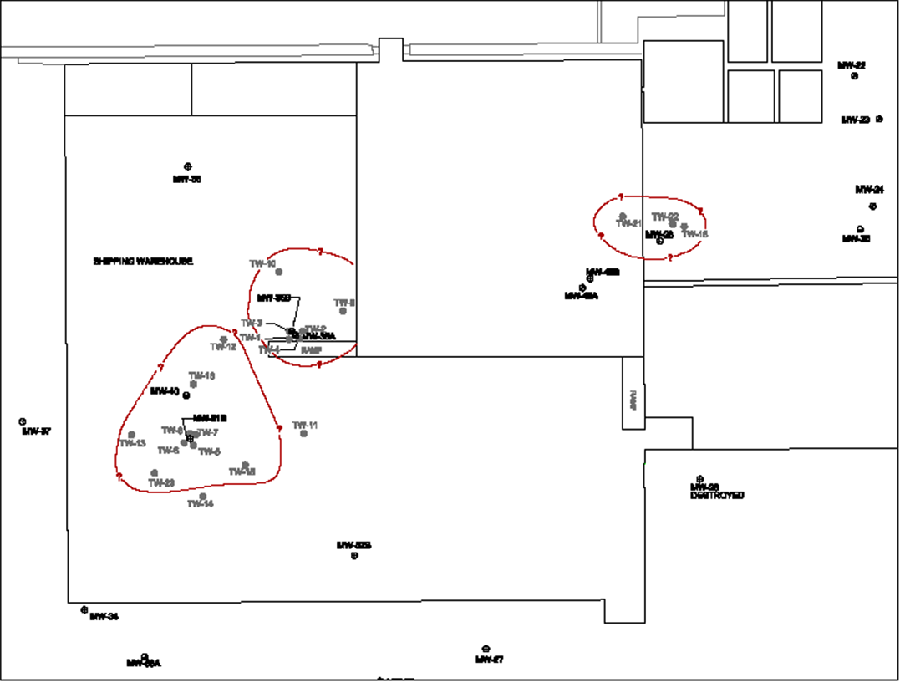
Former RCRA Facility (cont.)
Dissolved VOC Plume Prior to Plume Tracking
Prepared by Ken Summerour, P.G.
20

Slide 24
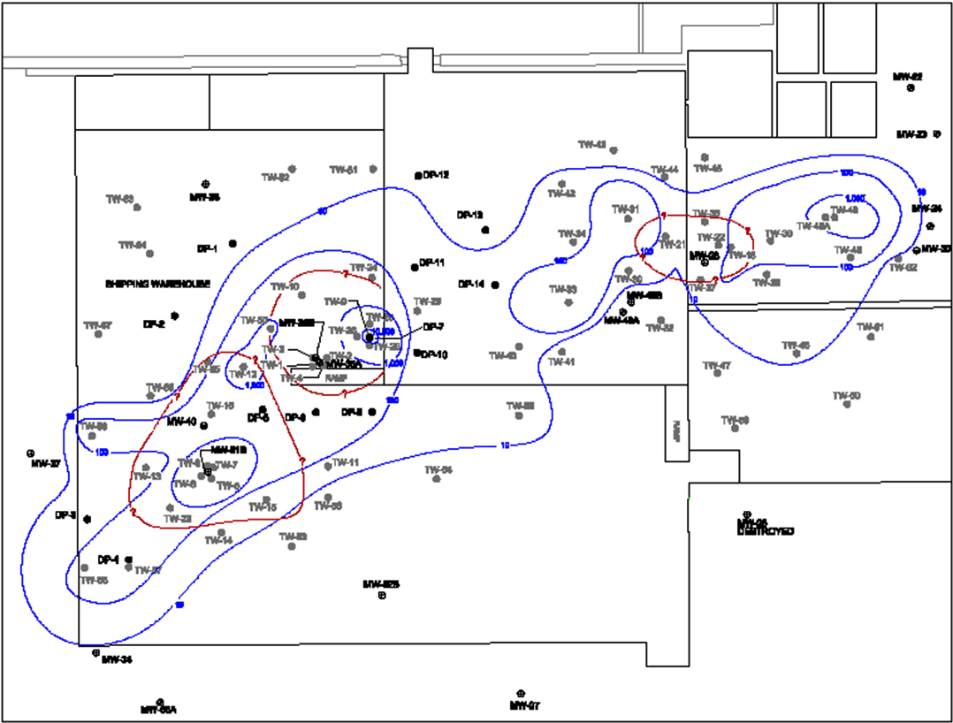
Former RCRA Facility (cont.)
Dissolved VOC Plume- After Plume Tracking
Prepared by Ken Summerour, P.G.
21

Slide 25
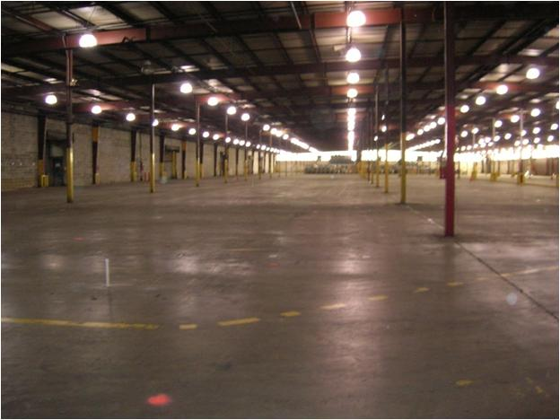
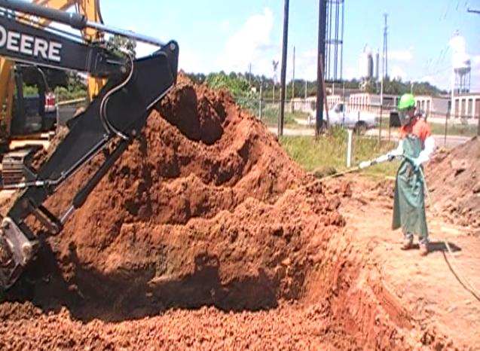
Former RCRA Facility (cont.)
Treatment Approach and Results
In 2008, alkaline activated sodium persulfate was injected into 911 injection wells.
Groundwater sampling indicated a 70% overall reduction in the VOC plume.
Limited follow-up injections were performed in 2009, 2011, and recently in May 2012. Quarterly monitoring is ongoing, with site closure expected in first quarter 2013.
In August 2011, soil blending of approximately 280 yd³ of impacted soils in the bulk storage area was performed using activated persulfate and CHP. Confirmatory sampling results indicated treatment goals were achieved without the need for soil removal.
Prepared by Ken Summerour, P.G.
22

Slide 26
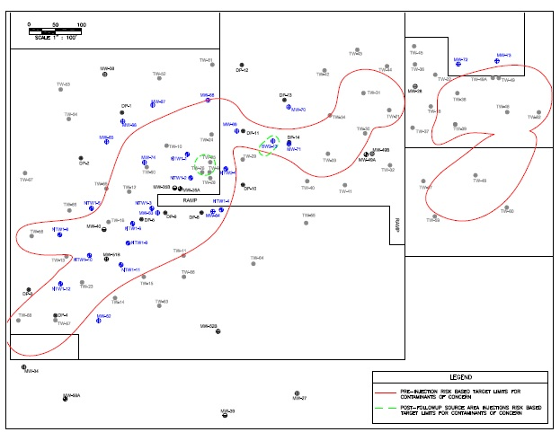
Former RCRA Facility (cont.)
Prepared by Ken Summerour, P.G.
23

Slide 27
Former RCRA Facility (cont.)
Prepared by Ken Summerour, P.G.
24

Slide 28
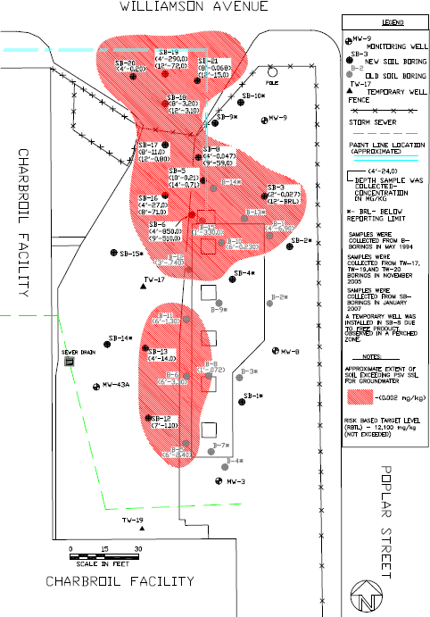
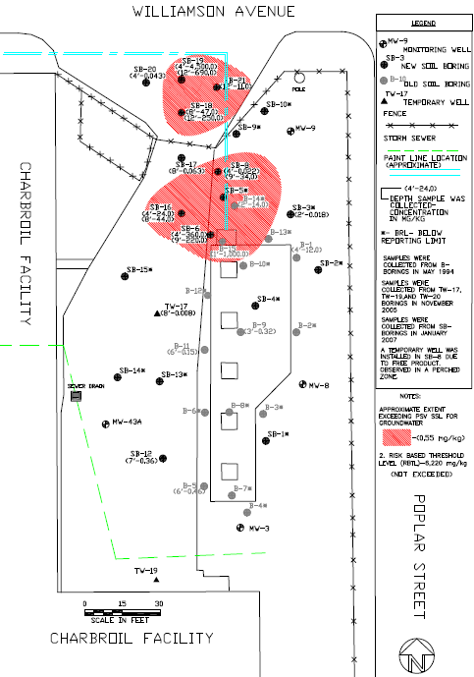
Former RCRA Facility (cont.)
Soil Blending Areas
Extent of naphthalene in soil
Extent of toluene in soil
Prepared by Ken Summerour, P.G.
25

Slide 29
Former RCRA Facility (cont.)
Soil Blending Results
Prepared by Ken Summerour, P.G.
26

Slide 30
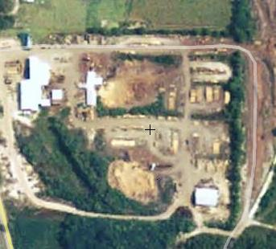
Wood Treatment Facility
Overview
Site located in Coastal Plain Province near the Okefenokee Swamp (very anoxic with low D.O. and pH).
Past discharges of creosote and pentachlorophenol (PCP) to a former surface impoundment area.
Low cost DPT assessment identified creosote NAPL, various PAHs, PCP, and phenolic com-pounds.
Contamination was detected in shallow and intermediate zones confined by a clay aquitard (55-65 deep).
Site
Former
Impoundment
Prepared by Ken Summerour, P.G.
27

Slide 31
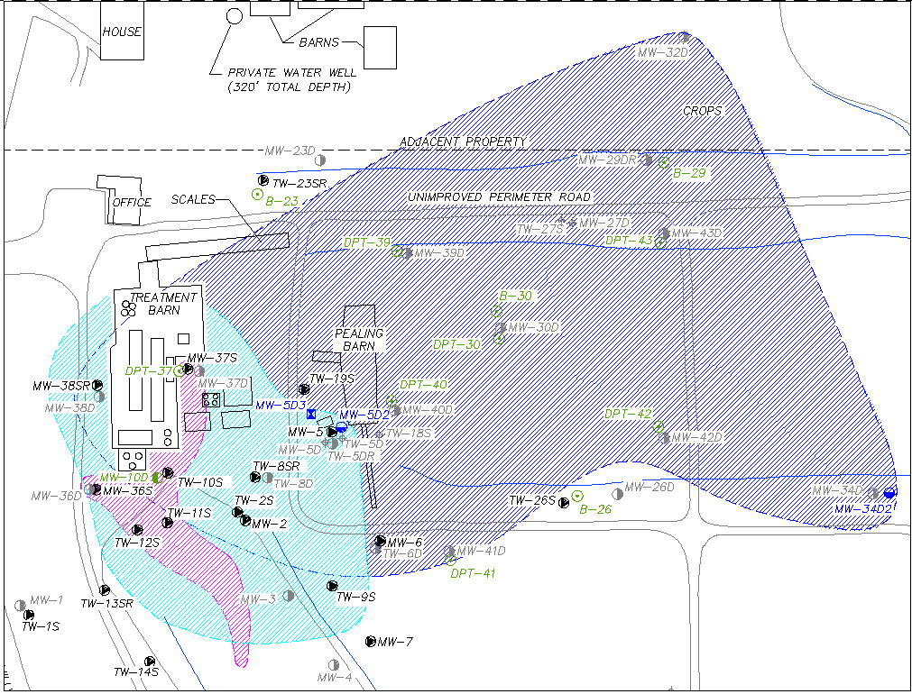
Wood Treatment Facility (cont.)
Extent of Contaminants Exceeding Thresholds
Intermediate GW Zone
Soil Treatment Zone
Shallow GW Zone
Prepared by Ken Summerour, P.G.
28

Slide 32
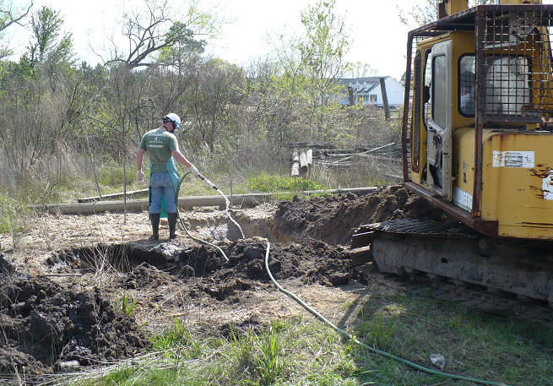
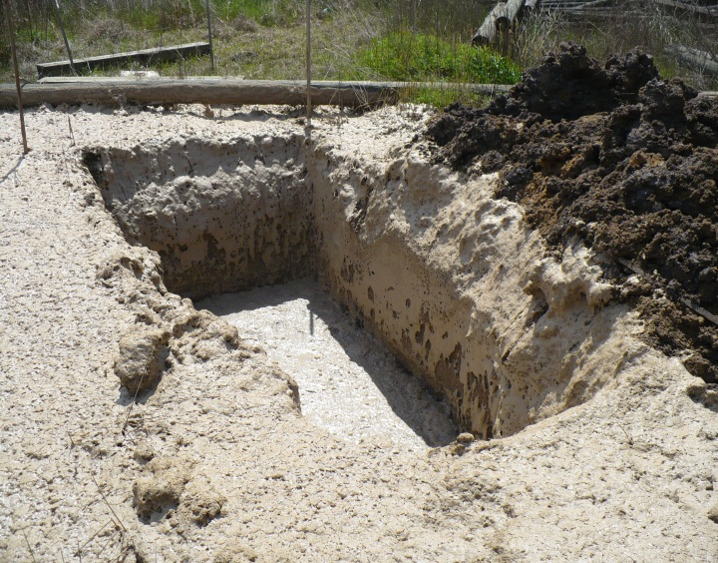

Wood Treatment Facility (cont.)
Field Application
A soil blending pilot was recently performed in the 1st quarter of 2012 using a higher volume dose of CHP only. The results indicated significant reduction exceeding target goals (see graph on next slide). Full scale treatment is tentatively scheduled for 2013.
Prepared by Ken Summerour, P.G.
30

Slide 33
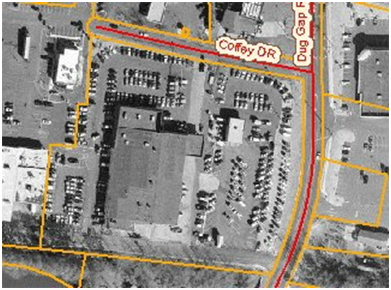
Former Auto Dealer
Overview
Auto dealership constructed in the 70’s after filling a low lying swamp
Located in Valley and Ridge Province, Conasauga Formation (limestone)
Groundwater depth 4 -13 ft-bgs in silty-clay/sandy-silt soils
Site
Prepared by Ken Summerour, P.G.
35

Slide 34
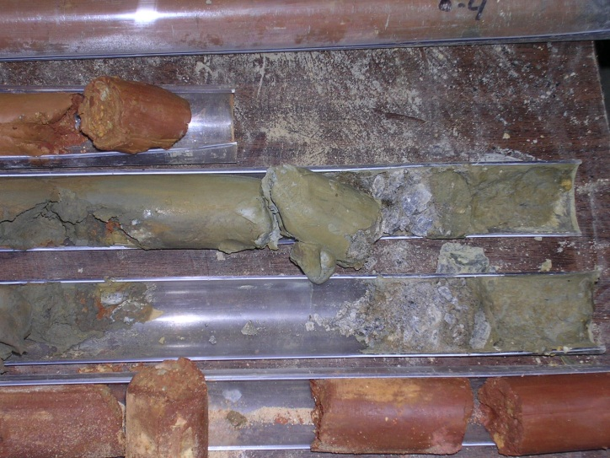
Former Auto Dealer
Assessment Summary
Gasoline petroleum release discovered after removal of 2,000 gallon gasoline UST and 500 gallon waste oil UST
Separate plumes detected from each UST pit area
(>220’ from gasoline UST mostly under a building)
Free product detected in 22 wells in thicknesses up to 1.4 feet.
Nearby intermittent stream located 50 feet south of waste oil pit
Envirorisk prepared CAP-A and CAP-B reports approved by Georgia EPD.
Prepared by Ken Summerour, P.G.
36

Slide 35
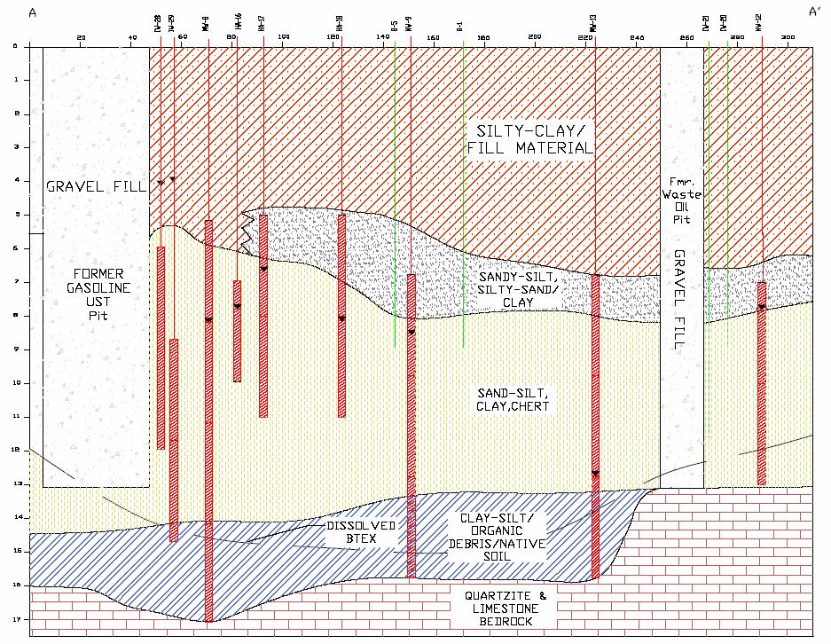
Former Auto Dealer
Geologic Cross-Section
Prepared by Ken Summerour, P.G.
37

Slide 36
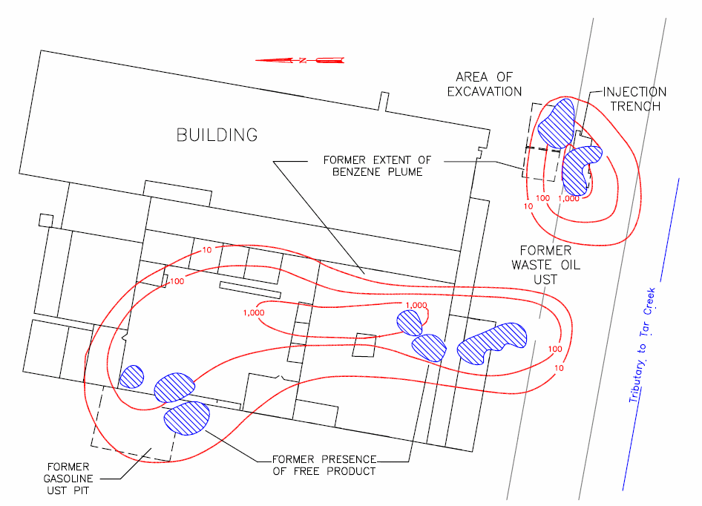
Former Auto Dealer
Site Map
Prepared by Ken Summerour, P.G.
38

Slide 37
Former Auto Dealer
ISCO Treatment
ISCO chosen due to site constraints (inside building) and for rapid clean up to facilitate sale
ISCO injections performed using CHP and activated persulfate.
Supplemental trench injection using activated persulfate was also performed following soil excavation along roadway.
Separate ISCO injection performed in waste oil pit using potassium permanganate to treat vinyl chloride.
Prepared by Ken Summerour, P.G.
39

Slide 38
Former Auto Dealer
Treatment Summary
Complete removal of free product.
Dissolved benzene/BTEX reduction in source area wells (MW-16 dissolved BTEX reduced from 163,500ppb → 1,680ppb).
Leading edge of plume treated/controlled.
Vinyl chloride eliminated with one injection.
NFA achieved without installation of perm-anent remediation system allowing sale of the property.
Prepared by Ken Summerour, P.G.
40

Slide 39
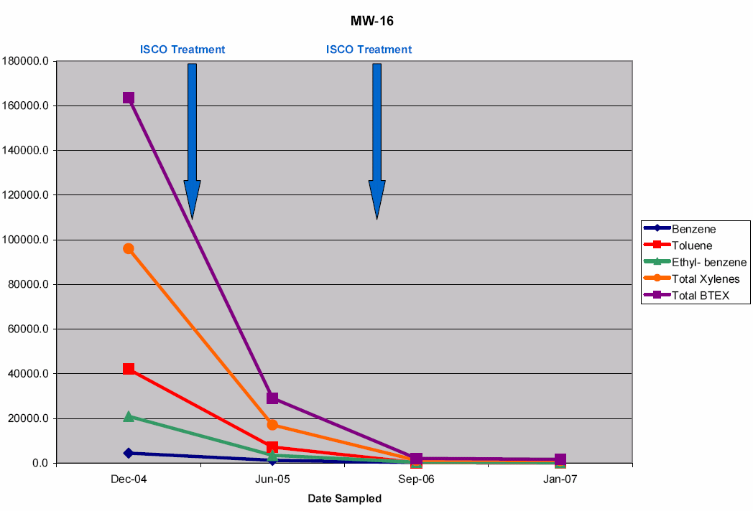
Former Auto Dealer
MW-16- north end under building
Prepared by Ken Summerour, P.G.
41

Slide 40
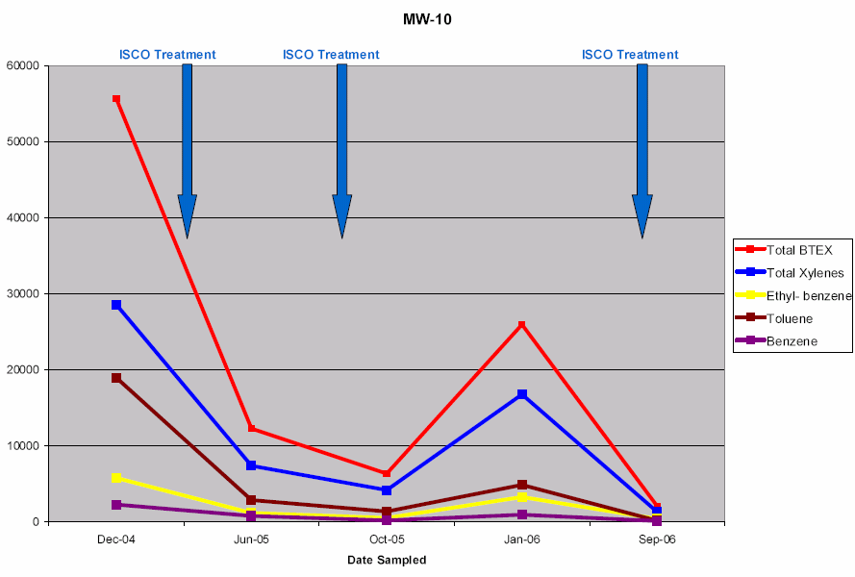
Former Auto Dealer
MW-10- south end under building
Prepared by Ken Summerour, P.G.
42

Slide 41

Summary: Keys to Success
Source area characterization, (vertical and horizontal), needed to estimate clean-up mass.
Choose the right oxidant/reductant and dose – treatability testing is always recommended.
Design a “best fit” treatment strategy (i.e. soil blending in source area, ISCO/ISCR mid-plume, enhanced bioremediation barrier down-gradient, etc.)
Consider checking soil/groundwater concentrations in between monitoring wells to better evaluate treatment.
Prepared by Ken Summerour, P.G.
43

